Slide 1


Queue Manager a practical introduction
By Michael Sluydts

Slide 2
You

Slide 3



Queue Manager
wien2k
VASP
?
Gaussian
Next

Slide 4
The modules
Core
Software
Error handling

Slide 5
Core
Templates
Workflows
Queues
Calculations
Materials

Slide 6
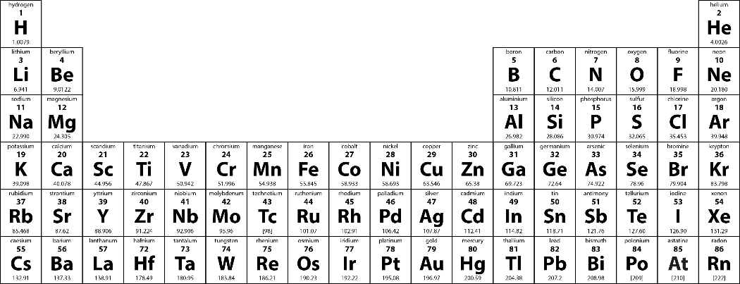
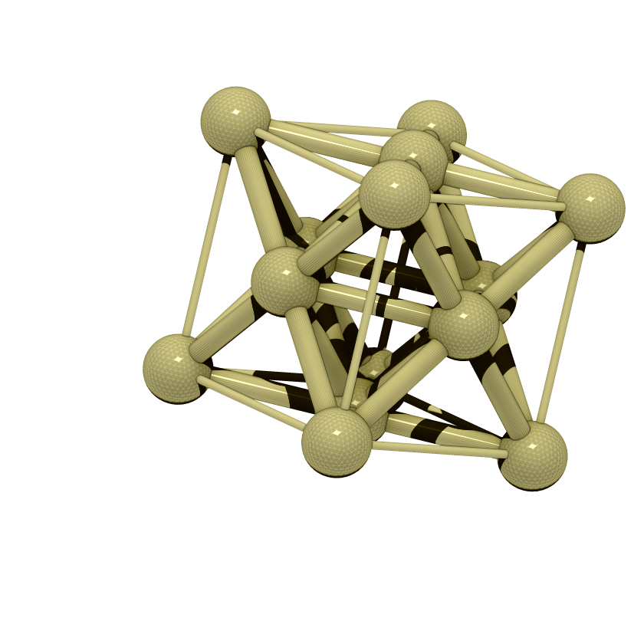
The goal

Slide 7
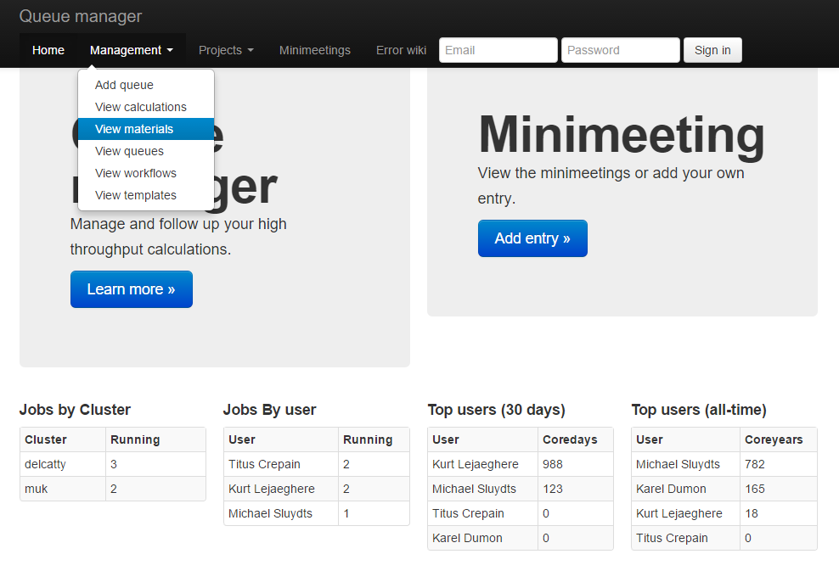
Logging into the website
http://physics.epotentia.com/queue

Slide 8
Logging in on the HPC
vsc40479@gligar01 /user/scratch/expert/#
export MODULEPATH=$MODULEPATH:/user/data/gent/gvo000/gvo00003/shared/modules
vsc40479@gligar01 /user/scratch/expert/#
module load ase
module load Python/2.7.9-intel-2015a
module load HighThroughput/beta0.0.1
vsc40479@gligar01 /user/scratch/expert/#
Python
> Import HighThroughput
> exit()
vsc40479@gligar01 /user/scratch/expert/#
vi ~/.highthroughput
* Not the guys who scooped Jan

Slide 9
Templates
Settings
Typical input file
Template
New input file
K-points
0
Monkhorst Pack
13 13 13
0 0 0
K-points
0
Monkhorst Pack
13 13 13
0 0 0
K-points
0
Monkhorst Pack
21 17 21
0 0 0
Results
Template
Results
Energy:
Volume:
Energy: -55.789
Volume: 50.541

Slide 10
Templates
Settings
VASP: {"INCAR": {"ISTART": "0", "NCORE": "1", "SYSTEM": "single point", "ENCUT": "400", "LCHARG": ".TRUE.", "ICHARG": "2", "IBRION": "-1", "PREC": "Accurate", "ISMEAR": "-5", "ISPIN": "1", "EDIFF": "1.0E-6", "LWAVE": ".FALSE."}, "KPOINTS": {"comment": "K-points", "shift": "0 0 0", "K": "13 13 13", "mode": "M"}, "POTCAR": "Ni"}
Gaussian: {"comment": "comment", "name": "test", "mem": "4GB", "multiplicity": "1", "route": "b3lyp/6-31+g** opt freq gfinput iop(6/7=3)", "chk": "minimum1", "charge": "0", "nproc": "16"}
Results
Example: { “Energy” : 0.0, “Volume” : 0.0}
Python dictionaries which get converted to and from input files (JSON-stored)
HighThroughput.manage.template
.add(name,value,software,ttype) .get(id) .modify({‘id’: id, …}) .remove(id)

Slide 11
Creating a template
vsc40479@gligar01 /user/scratch/expert/#
cp -r $VSC_DATA_VO/shared/HTtutorial $VSC_SCRATCH
vsc40479@gligar01 /user/scratch/expert/#
cd HTtutorial/demorel
vsc40479@gligar01 /user/scratch/expert/#
python
> import HighThroughput
> settings = {}
> HighThroughput.modules.VASP.readSettings(settings)
> settingsid = HighThroughput.manage.template.add('Relax template',settings,'VASP','settings')
> results = {'E0': 0.0, 'V0' : 0.0}
resultsid = HighThroughput.manage.template.add(‘Results template',results,'VASP', 'results')
vsc40479@gligar01 /user/scratch/expert/#
Repeat for demoSP and check site
* Not the guys who scooped Jan

Slide 12
Workflows
Linear sequences of templates
Step 1
Settings Template
Results Template
Step 2
Settings Template
Results Template
Each step has multiple statuses
Step 1 Waiting
Step 1
Step 1 Running
Step 1 Done

Slide 13
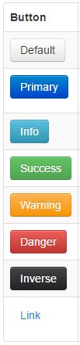
Creating a workflow
vsc40479@gligar01 /user/scratch/expert/#
python
> name = 'Basic'
> button = ['Not Started', 'Relaxing V', 'Relaxed', 'SPing', 'Finished']
> description = ['Waiting', 'Relaxing [server]', 'Relaxed', 'SPing [server]', 'Finished [results:V0]']
> buttonclass = ['warning','info','warning','info' ,'success']
> stemplates = [id1,id1,id1,id2,id2]
> entries = [{'stat' : i, 'stemplate' : stemplates[i], 'rtemplate' : resultsid, 'description' : description[i], 'buttonname' : button[i], 'buttonclass' : buttonclass[i], 'priority' : 1} for i in range(0,len(button))]
> wid = HighThroughput.manage.workflow.add(name,entries)
Check the site for IDs + workflow
HighThroughput.manage.workflow
.add(name,entries) .showAll(id) .modify({‘id’: id, …})
.remove(id,stat) .removeAll(id) .setPriority()
* Not the guys who scooped Jan

Slide 14
Queues
Workflow 1
Workflow 1
Workflow 2
Queue 1
Queue 2
Queue 3
Calculation 1
Calculation 1
Calculation 1
Calculation 2
Calculation 2
Calculation 2
Calculation 3
Calculation 3
Calculation 3
Calculation 4
Calculation 4
Calculation 4
Calculation 5
Calculation 5
Calculation 5

Slide 15
Creating a queue
vsc40479@gligar01 /user/scratch/expert/#
python
> qid = HighThroughput.manage.queue.add('Tutorial', wid)
Check the site for IDs + queue
Setting up directories
vsc40479@gligar01 /user/scratch/expert/#
python
mkdir $VSC_SCRATCH/queues
mkdir $VSC_SCRATCH/queues/<qid>
mkdir $VSC_SCRATCH/queues/<qid>/CALCULATIONS
mkdir $VSC_SCRATCH/queues/<qid>/LOGFILES
HighThroughput.manage.queue
.add(name, workflow, fields, dir) .showAll(id) .modify({‘id’: id, …}) .remove(id)
* Not the guys who scooped Jan

Slide 16
Materials and calculations
Materials are the input geometry
Material
Calculation 1
Workflow
Stored in CIF format with CIFID based on crystallography.net
Input file
New Material
Existing Material

Slide 17
Generating materials
vsc40479@gligar01 /user/scratch/expert/#
cd HTtutorial/import
cat POSCAR
Python vol.py
Rm vol.py
Rm POSCAR
python
> HighThroughput.manage.material.importdir()
for i in *;do mv $i $i.vasp;done
cd ../
mv import $VSC_SCRATCH/queues/<qid>
Importing materials
vsc40479@gligar01 /user/scratch/expert/#
vsc40479@gligar01 /user/scratch/expert/#
HighThroughput.manage.material
.add(name) .get(cifid) .modify({‘id’: id, …}) .importdir()
Check the site for materials
* Not the guys who scooped Jan

Slide 18
Adding calculations
vsc40479@gligar01 /user/scratch/expert/#
python
>for i in [cifid1,cifd2,cifid3]:
... HighThroughput.manage.calculation.add(i,qid,0)
Check the site for calculations within your queue
HighThroughput.manage.calculation
.add(material,queue,priority = '',settings = None,results = None, status = 0)
.fetchgetstart(id) .fetch(qid) .get(id) .start(id) .remove(id)
.restart(id) .rollback(status, id)
.setPriority(priority,id)
.getResults(id) .updateResults(results,id)
.getSettings(id) .updateSettings(settings,id)
* Not the guys who scooped Jan

Slide 19
Building a submit script
Core:
fetchgetstart(qid) #obtain status +cifid of next calc
<Copy over files and setup dirs based on id+stat>
writeSettings() #if template modified (optional)
run()
end()
updateResults()
Checkpointing:
checkpointStart(calculation,timebeforewalltimeto abort)
Continue:
continue and continued parameter in settings of previous workflow step (continued < continue = run again)

Slide 20
Running calculations
vsc40479@gligar01 /user/scratch/expert/#
mkdir ~/bin/HTtools
export PATH=$PATH:~/bin/HTtools
cp Httutorial/scripts/* :~/bin/HTtools
vsc40479@gligar01 /user/scratch/expert/#
tutsubmit <qid> <hours> <nodes> <cores>
module swap cluster/…
tutsubmit …
module swap …
tutsubmit …
Set the refresh rate to 1000 ms and monitor your queue
* Not the guys who scooped Jan

Slide 21
Check the real scripts

Slide 22
Single jobs
Make default queue with basic template and 1 step workflow
INCAR = readINCAR()
if 'CALCID' in INCAR.keys():
sid = INCAR['CALCID']
else:
os.mkdir('import')
os.chdir('import')
shutil.copy('../POSCAR','POSCAR' + INCAR['SYSTEM'])
#Could have a mat argument for COD entries
matid = material.add('POSCAR' + INCAR['SYSTEM'])
sid = calc.add(matid,args.queue)
calc.modify({'id' : cid, 'file' : matid})
os.chdir('../')
calc.start(sid)

Slide 23
Detectors
Error handling
Fixes
grep Error
rmDensity
rmWaveFc
incBasisset
Error Flow
…
www.error.wiki

Slide 24
Adding error fixing
Script:
fixerrors()
run()
finderrors()
finderrors():
cat /user/data/gent/gvo000/gvo00003/shared/bin/HT/beta0.0.1/HighThroughput/errors/VASPdetectors.py
Fixerrors():
cat /user/data/gent/gvo000/gvo00003/shared/bin/HT/beta0.0.1/HighThroughput/errors/VASPfixes.py

Slide 25
Run
Software
Continue
Abort
ParallelSetup

Slide 26
Developing modules
Software module:
cat /user/data/gent/gvo000/gvo00003/shared/bin/HT/beta0.0.1/HighThroughput/modules/VASP.py
Runs a calculation.
i/o module:
cat /user/data/gent/gvo000/gvo00003/shared/bin/HT/beta0.0.1/HighThroughput/io/VASP.py
Reads/writes input files and geometry.
Modules are optional and not all functions are needed. The end function does require the geometry to be read in, but could be excluded.

