Slide 1


Queue Manager or how to make yourself redundant.
By Michael Sluydts

Slide 2
You

Slide 3
The day of reckoning
Schedule:
9:00 - 9:30 Submit calculations
9:30-17:30 Read “An Awesome review” written by “Some Very Intelligent People”

Slide 4
vsc40479@gligar01 /user/scratch/expert/#
for i in {1..10000};
do qsub simple.sh;
done
123506.master19.cluster.gent.vsc
123507.master19.cluster.gent.vsc
123508.master19.cluster.gent.vsc
123509.master19.cluster.gent.vsc
123510.master19.cluster.gent.vsc
.
.
.
133505.master19.cluster.gent.vsc

Slide 5
A very Awesome review
by Some Very Smart People *
Even in the first paragraph this text is sure to contain some very awesome information gathered from some similarly awesome sources. By reading this text you are certain to increase your insight in your undoubtably awesome research topic.
expert@modelling.com
1 new message
* Not the guys who scooped Jan
Local HPC – Job finished

Slide 6
cat output1
vsc40479@gligar01 /user/scratch/expert/#
Not so awesome error in MPI subprocess 554962.
%&@%&*)#$%&($^(&#$Y&^$%M#*^$%^)*$% in input1.
vi input1
vsc40479@gligar01 /user/scratch/expert/#
Parameter1=“1’
* Not the guys who scooped Jan

Slide 7
expert@modelling.com
expert@modelling.com
expert@modelling.com
expert@modelling.com
1 new message
1 new message
1 new message
1 new message
Local HPC – Job finished
A very Awesome review
Local HPC – Job finished
Local HPC – Job finished
Local HPC – Job finished
expert@modelling.com
expert@modelling.com
expert@modelling.com
expert@modelling.com
cat output1
vsc40479@gligar01 /user/scratch/expert/#
1 new message
1 new message
1 new message
1 new message
Not so awesome error in MPI subprocess 554962.
%&@%&*)#$%&($^(&#$Y&^$%M#*^$%^)*$% in input1.
Local HPC – Job finished
Local HPC – Job finished
Local HPC – Job finished
Local HPC – Job finished
expert@modelling.com
expert@modelling.com
expert@modelling.com
vi input1
expert@modelling.com
vsc40479@gligar01 /user/scratch/expert/#
1 new message
1 new message
1 new message
1 new message
Parameter1=“1’
Local HPC – Job finished
Local HPC – Job finished
Local HPC – Job finished
Local HPC – Job finished
expert@modelling.com
expert@modelling.com
expert@modelling.com
expert@modelling.com
1 new message
1 new message
1 new message
1 new message
Local HPC – Job finished
Local HPC – Job finished
Local HPC – Job finished
Local HPC – Job finished
expert@modelling.com
expert@modelling.com
expert@modelling.com
expert@modelling.com
1 new message
1 new message
1 new message
1 new message
Local HPC – Job finished
Local HPC – Job finished
Local HPC – Job finished
Local HPC – Job finished
expert@modelling.com
expert@modelling.com
expert@modelling.com
expert@modelling.com
1 new message
1 new message
1 new message
1 new message
Local HPC – Job finished
Local HPC – Job finished
Local HPC – Job finished
Local HPC – Job finished
expert@modelling.com
expert@modelling.com
expert@modelling.com
expert@modelling.com
1 new message
1 new message
1 new message
1 new message
Local HPC – Job finished
Local HPC – Job finished
Local HPC – Job finished
Local HPC – Job finished
* Not the guys who scooped Jan

Slide 8
A very Awesome review
by Some Very Smart People *
Even in the first paragraph this text is sure to contain some very awesome information gathered from some similarly awesome sources. By reading this text you are certain to increase your insight in your undoubtably awesome research topic.
Before we get to the awesome stuff there are however some slightly less awesome concepts we must introduce. This, amongst others, includes the degree of awesomeness for a given article Aa written by a given author Aw.
expert@modelling.com
1 new message
* Not the guys who scooped Jan
Local HPC – Job finished

Slide 9
cat output1
vsc40479@gligar01 /user/scratch/expert/#
Job finished succesfully
vi input1
vsc40479@gligar01 /user/scratchexpert/#
Parameter1=“2”
qsub submit.sh
vsc40479@gligar01 /user/scratchexpert/#
125793.master19.cluster.gent.vsc
* Not the guys who scooped Jan

Slide 10
A very Awesome review
by Some Very Smart People *
Even in the first paragraph this text is sure to contain some very awesome information gathered from some similarly awesome sources.
By reading this text you are certain to increase your insight in your undoubtably awesome research topic.
improve the model previously proposed by SVSP et al.
Before we get to the awesome stuff there are however some slightly less awesome concepts we must introduce. This, amongst others, includes the degree of awesomeness for a given article Aa written by a given author Aw. We hereby take the chance to
expert@modelling.com
1 new message
* Not the guys who scooped Jan
Local HPC – Job finished

Slide 11
cat output2
vsc40479@gligar01 /user/scratch/expert/#
Job finished succesfully
vi input2
vsc40479@gligar01 /user/scratchexpert/#
Parameter1=“2”
qsub submit.sh
vsc40479@gligar01 /user/scratchexpert/#
125793.master19.cluster.gent.vsc
* Not the guys who scooped Jan

Slide 12
A very Awesome review
by Some Very Smart People *
Even in the first paragraph this text is sure to contain some very awesome information gathered from some similarly awesome sources. By reading this text you are certain to increase your insight in your undoubtably awesome research topic.
improve the model previously proposed by SVSP et al.
In this article Aa was defined as a function of Aw:
Aa = [Aw = 1]
Before we get to the awesome stuff there are however some slightly less awesome concepts we must introduce. This, amongst others, includes the degree of awesomeness for a given article Aa written by a given author Aw. We hereby take the chance to
expert@modelling.com
1 new message
* Not the guys who scooped Jan
Local HPC – Job finished

Slide 13


Slide 14
Time for automation
Queue Manager

Slide 15



Queue Manager
wien2k
VASP
?
Gaussian
Next

Slide 16
The modules
Core
Software
Error handling

Slide 17
Materials
Core
Templates
Workflows
Queues

Slide 18
Queue manager
Queue 1
Not started
Running
Finished
Queue 2
Queue 3
Queue 4
Queue 5
Queue 6

Slide 19
Queue manager
Queue 1
Not started
Running
Finished
Queue 2
Queue 3
ID
Name
Material
Status
Job ID
Start
End
Queue 4
Waiting
1
Waiting
15111
1
Si-O
Si-O
15111
Queue 5
15111
Queue 6
2
2
MIL-49
13459
MIL-49
13459
13459
Waiting
Waiting
H2
10001
H2
10001
3
10001
3
Waiting
Waiting
Cd surf
17984
Cd surf
17984
4
17984
4
Waiting
Waiting
NaAlAsS4
16254
NaAlAsS4
16254
16254
Waiting
5
Waiting
5

Slide 20





Queue manager
Queue 1
Not started
Running
Finished
Queue 2
Queue 3
ID
Name
Material
Status
Job ID
Start
End
Queue 4
Running
Waiting
Waiting
15111
1
15111
1
Si-O
Si-O
15111
1
Si-O
15111
11:43
Queue 5
15111
Queue 6
Running
2
11:41
2
2
13459
MIL-49
13459
MIL-49
13459
MIL-49
13459
13459
Waiting
Waiting
Running
10001
H2
10001
11:45
H2
10001
H2
10001
3
10001
3
3
Waiting
Waiting
Cd surf
Running
17984
Cd surf
17984
4
17984
17984
4
Cd surf
17984
4
Waiting
Waiting
11:42
Running
16254
NaAlAsS4
16254
NaAlAsS4
16254
NaAlAsS4
16254
16254
Waiting
5
Waiting
11:44
5
5

Slide 21
Queue manager
Queue 1
Not started
Running
Finished
Queue 2
Queue 3
ID
Name
Material
Status
Job ID
Start
End
Queue 4
Running
1
Energy:
5.431 eV
Waiting
Waiting
15111
15111
1
Si-O
15111
15111
11:43
1
1
Si-O
Si-O
15111
1
Si-O
15111
15111
11:43
11:48
Queue 5
15111
Queue 6
Running
2
Energy:
20.71 eV
11:41
2
2
2
13459
11:41
11:50
13459
MIL-49
13459
13459
MIL-49
MIL-49
13459
2
13459
Waiting
MIL-49
13459
Waiting
13459
Running
3
Energy:
0.456 eV
10001
11:45
10001
H2
10001
10001
H2
H2
10001
3
10001
3
3
Waiting
3
H2
10001
Waiting
10001
11:45
11:46
Running
4
Energy:
11.45 eV
17984
4
17984
Cd surf
17984
Cd surf
17984
4
Cd surf
17984
4
17984
4
11:42
11:49
Waiting
11:42
Cd surf
17984
Waiting
17984
Running
5
Energy:
10.87 eV
16254
16254
NaAlAsS4
16254
16254
NaAlAsS4
NaAlAsS4
16254
16254
Waiting
11:44
5
Waiting
5
5
NaAlAsS4
16254
16254
11:44
11:47
5

Slide 22
Run
Software
Continue
Abort
ParallelSetup

Slide 23
Detectors
Error handling
Fixes
grep Error
rmDensity
rmWaveFc
incBasisset
Error Flow
…
www.error.wiki

Slide 24
Queue Manager
Use cases

Slide 25
Case 1: Massive screening
Search space
Random or sequential exploration

Slide 26
Case 2: Intelligent screening
Search space
Biased exploration
Example: Zintl phases (Titus Crepain/Karel Dumon)

Slide 27
Case 3: Systematic settings increase
Low calculation
Heavy calculation
Medium calculation
Heavy calculation
Example: HSE06 elemental materials (Kurt Lejaeghere)

Slide 28
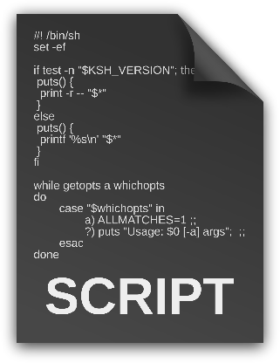


Case 4: Test queues + post-processing
Automatic benchmark generation.
Example: Scaling/Compilation tests

Slide 29

Case 5: external queue (+error fixing)
Clusters
Queue
Your “queue”

Slide 30
Case 5: external queue (+error fixing)
Clusters
Queue
Your “queue”

Slide 31
Case 5: external queue (+error fixing)
Clusters
Queue
Queue
Manager
Your “queue”

Slide 32

A very Awesome review
by Some Very Smart People *
Even in the first paragraph this text is sure to contain some very awesome information gathered from some similarly awesome sources. By reading this text you are certain to increase your insight in your undoubtably awesome research topic.
Before we get to the awesome stuff there are however some slightly less awesome concepts we must introduce. This, amongst others, includes the degree of awesomeness for a given article Aa written by a given author Aw.
We hereby take the chance to
improve the model previously proposed by SVSP et al. In this article Aa was defined as a function of Aw:
Aa = [Aw = 1]
With the following definition used for Aw:
Aw = [author = SVSP]
This was surprisingly considered too strict by many of the users and we have thus redefined both Aa and Aw in terms of the SVSP number Ns:
Aa = exp(Aw)
Aw = exp(-Ns)
* Not the guys who scooped Jan

Slide 33
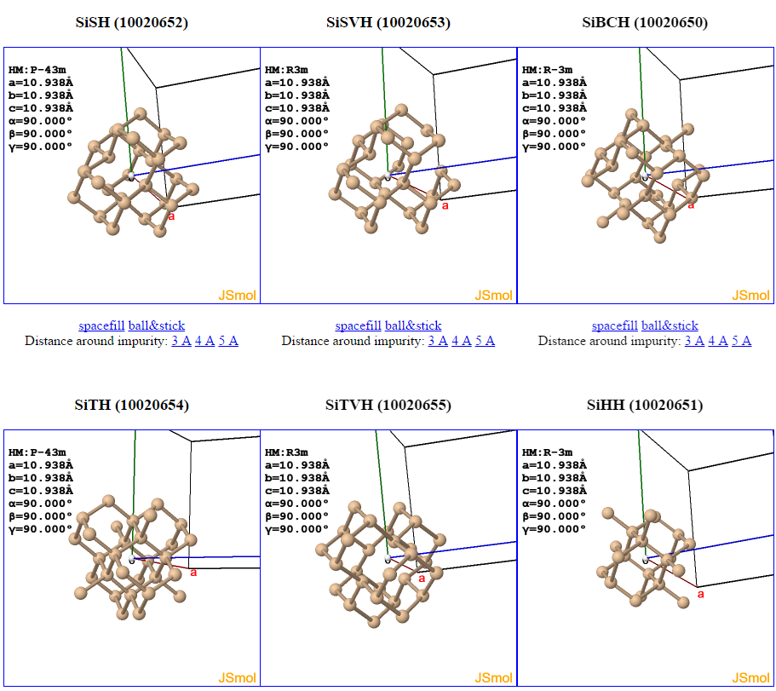
Case 1: Massive screening
Example: Si/Ge defects (Michael Sluydts)

Slide 34
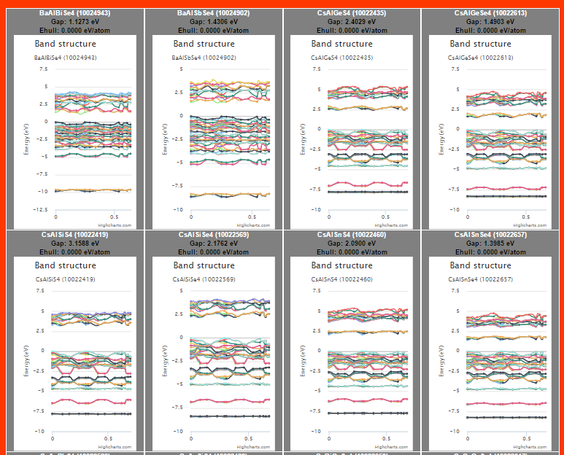
Case 2: Intelligent screening
Example: Zintl phases (Titus Crepain/Karel Dumon)

